Slide 1
Machine Learning DSECL ZG565
Dr. Chetana Gavankar, Ph.D,
IIT Bombay-Monash University Australia
Chetana.gavankar@pilani.bits-pilani.ac.in

Slide 2
Lecture No. – 7 | Decision Tree
Date – 11/10/2020
Time – 2:00 PM – 4:00 PM

Slide 3
Session Content
(Tom Mitchell Chapter 3 page 67)
Overfitting
Regularization
Bias Variance Decomposition
Decision Tree
Handling overfitting
Continuous values
Missing Values

Slide 4
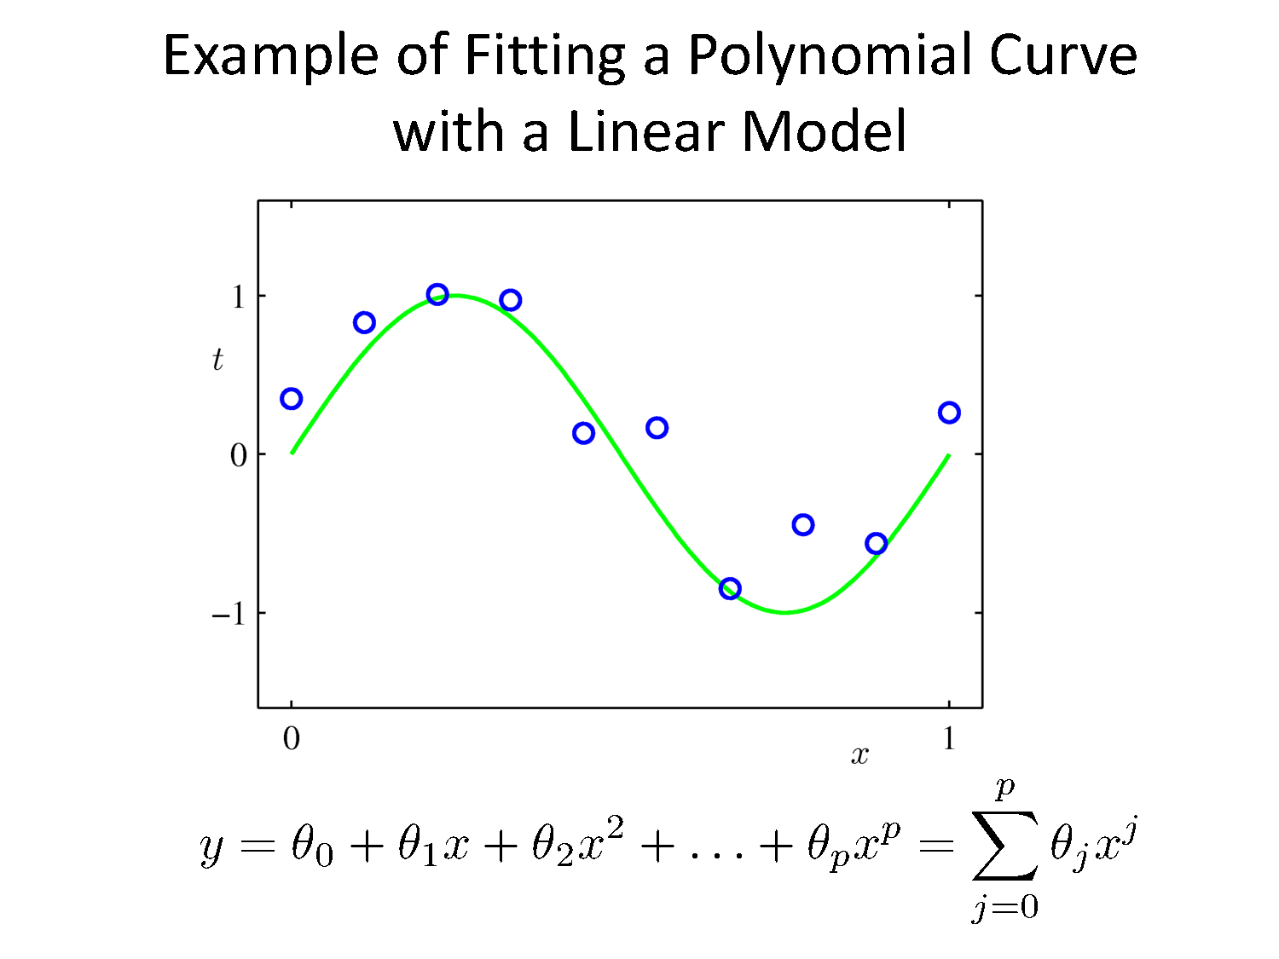

Slide 5
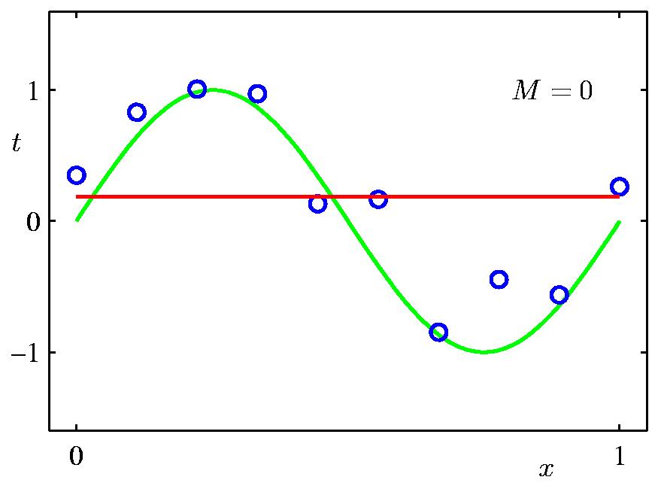

Linear Regression Problem
( x₁y₁, x₂y₂,…………. x_{n}y_{n})
y(x,w) = w₀+w₁x
min $\frac{1}{2}\sum_{n=1}^{N}{[\text{(}\text{w}\text{0}\text{+}\text{w}\text{1}\text{x}\text{n} \text{) −}\text{yn}\text{]2}}$

Slide 6
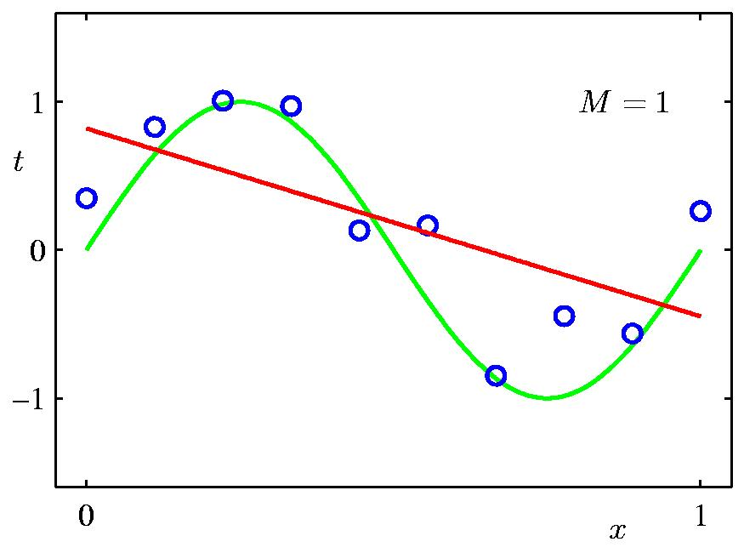
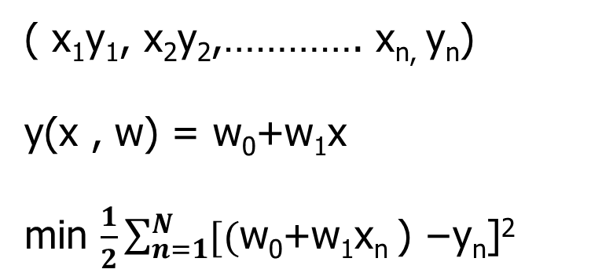
Model Selection - 1st Order Polynomial
( x₁y₁, x₂y₂,…………. x_{n,} y_{n})
y(x , w) = w₀+w₁x
min $\frac{1}{2}\sum_{n=1}^{N}{[\text{(}\text{w}\text{0}\text{+}\text{w}\text{1}\text{x}\text{n} \text{) −}\text{yn}\text{]2}}$

Slide 7
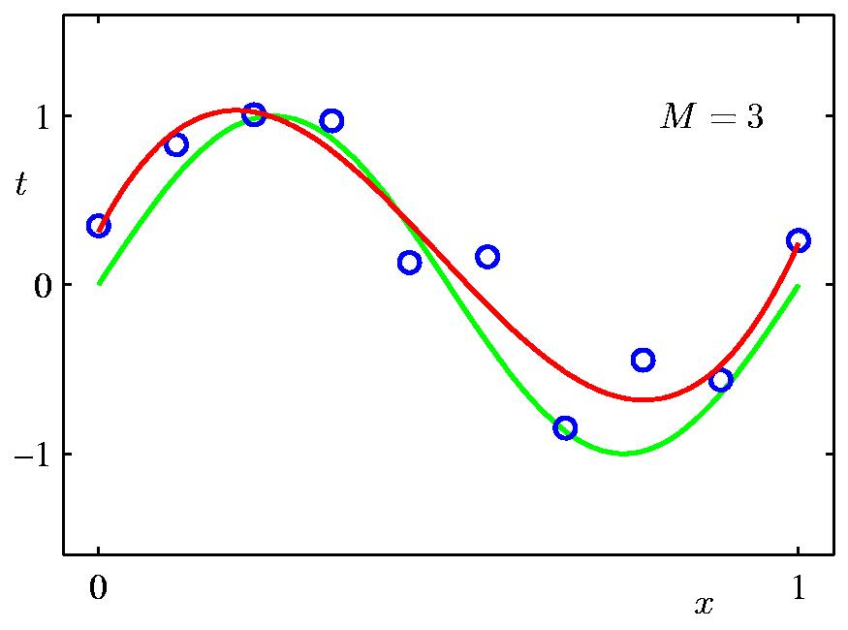
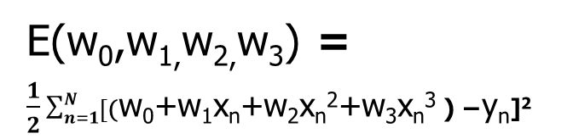
Model Selection - 3rd Order Polynomial
( x₁y₁, x₂y₂,…………. x_{n}y_{n})
y= w₀+w₁x+w₂x²+w₃x³
E(w₀,w_{1,}w_{2,}w₃) = $\frac{1}{2}\sum_{n=1}^{N}{[\text{(}\text{w}\text{0}\text{+}\text{w}\text{1}\text{x}\text{n}\text{+}\text{w}\text{2}\text{x}\text{n}\text{2}\text{+}\text{w}\text{3}\text{x}\text{n}\text{3 }\text{) −}\text{y}\text{n}\text{]}\text{2} }$

Slide 8
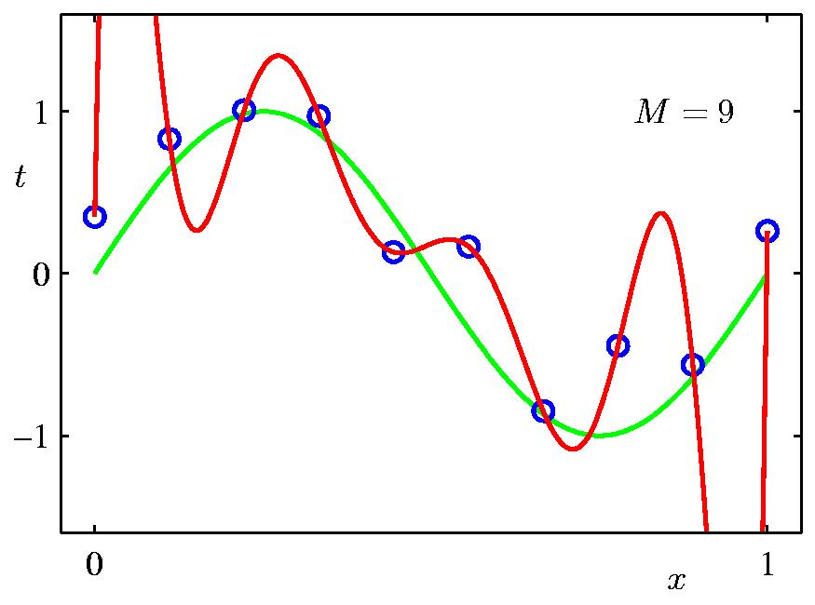
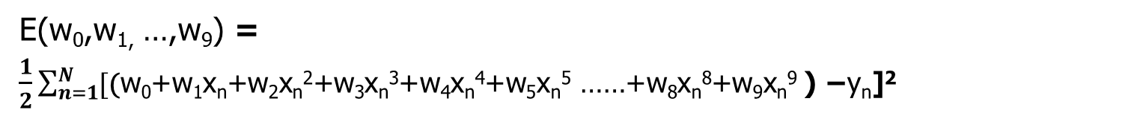
Model Selection - 9th Order Polynomial
( x₁y₁, x₂y₂,…………. x_{n}y_{n})
y= w₀+w₁x+w₂x²+w₃x³+w₄x⁴+w₅x⁵ ……+w₈x⁸+w₉x⁹
E(w₀,w_{1,} …,w₉) = $\frac{1}{2}\sum_{n=1}^{N}{[\text{(}\text{w}\text{0}\text{+}\text{w}\text{1}\text{x}\text{n}\text{+}\text{w}\text{2}\text{x}\text{n}\text{2}\text{+}\text{w}\text{3}\text{x}\text{n}\text{3}\text{+}\text{w}\text{4}\text{x}\text{n}\text{4}\text{+}\text{w}\text{5}\text{x}\text{n}\text{5}\text{ ……+}\text{w}\text{8}\text{x}\text{n}\text{8}\text{+}\text{w}\text{9}\text{x}\text{n}\text{9 }\text{) −}\text{y}\text{n}\text{]}\text{2} }$

Slide 9
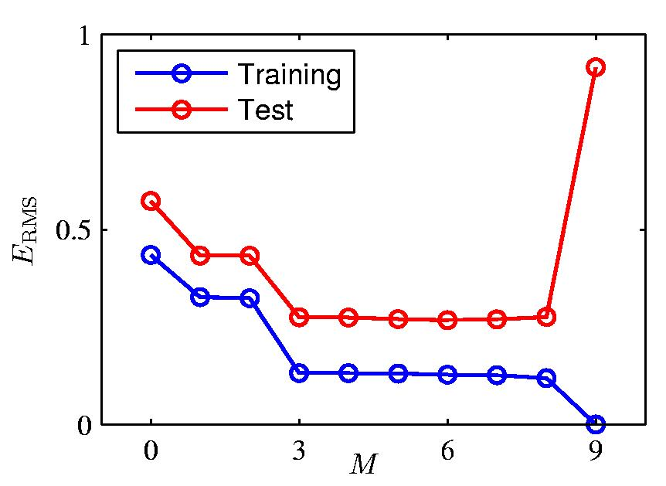
Overfitting

Slide 10
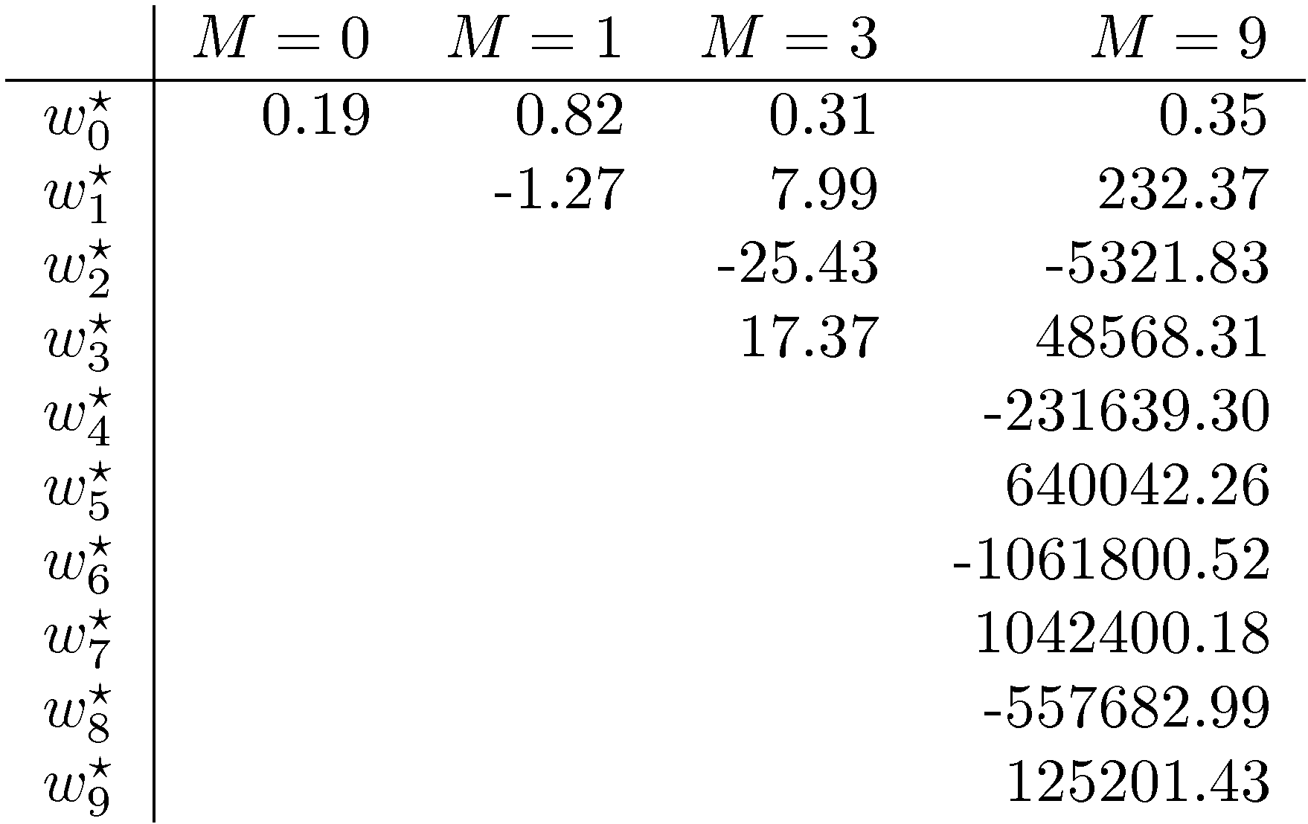
Overfitting
Polynomial Coefficients

Slide 11
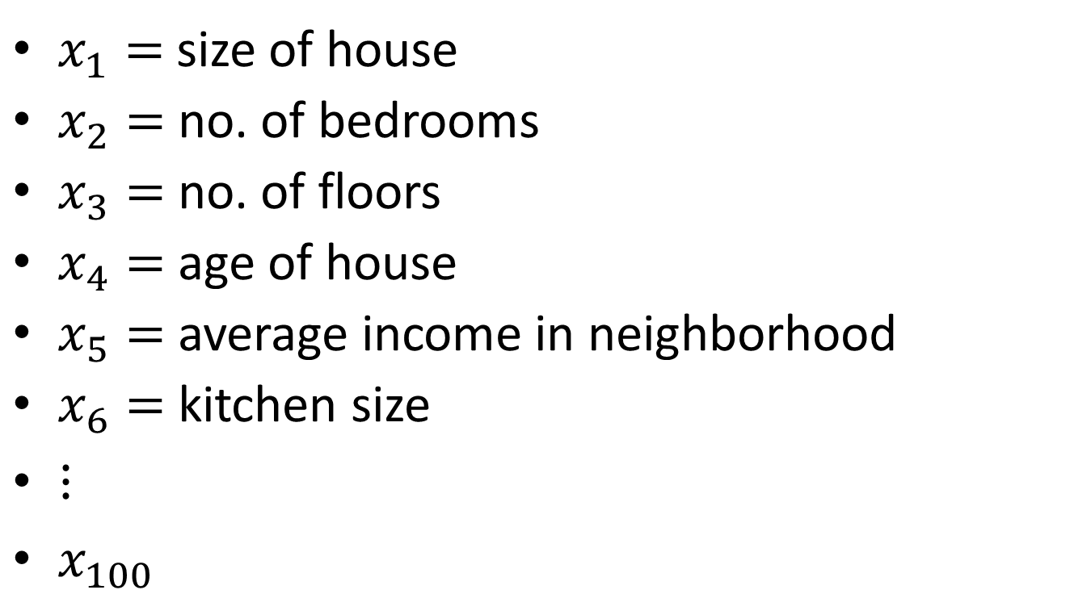
Addressing overfitting
$x_{1}=$ size of house
$x_{2}=$ no. of bedrooms
$x_{3}=$ no. of floors
$x_{4}=$age of house
$x_{5}=$average income in neighborhood
$x_{6}=$ kitchen size
$⋮$
$x_{100}$
Price ($) in 1000’s
Size in feet^2

Slide 12
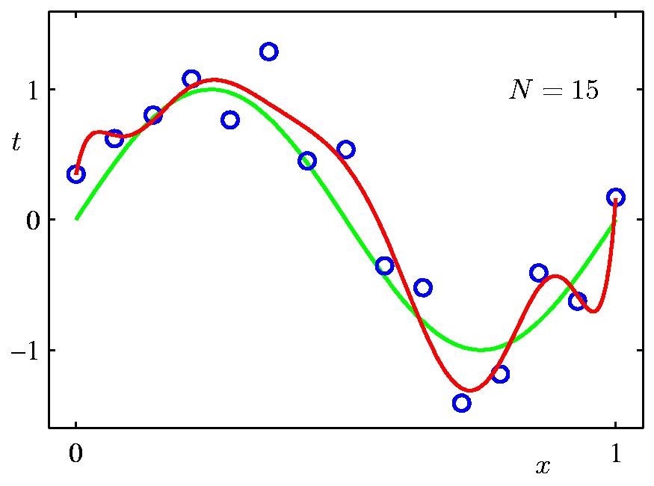
Increasing input data size
Data Set Size: N = 15
9th Order Polynomial

Slide 13
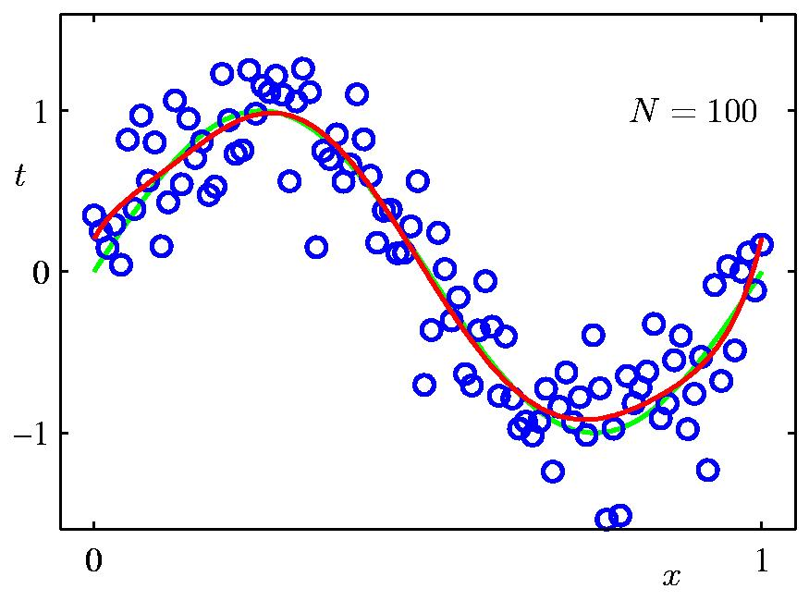
Data Set Size: N = 100
Increasing input data size
9th Order Polynomial

Slide 14
Combatting Overfitting
Problem of overfitting can be overcome by increasing the input training data points
Number of input data points should be at least more than 10 times the number of parameters or features
But what if we have less data points:
Put a bound on regression coefficients by using regularization

Slide 15
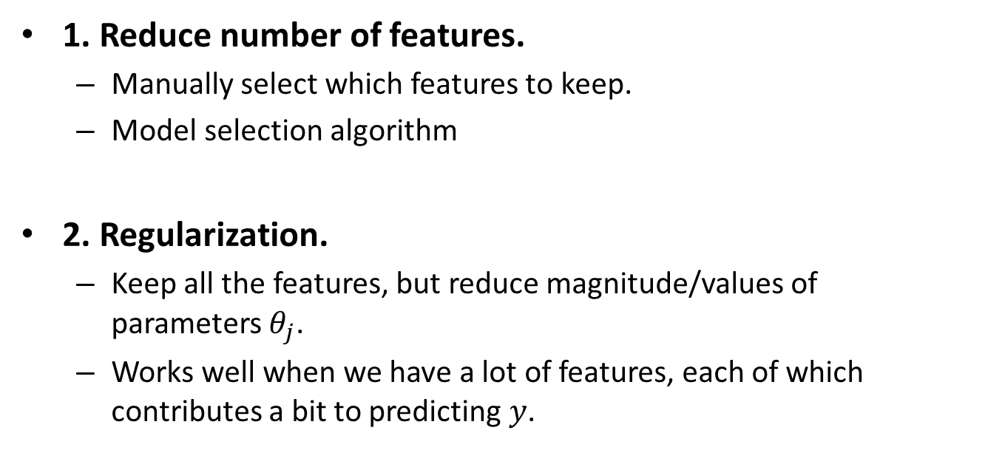
Addressing overfitting
1. Reduce number of features.
Manually select which features to keep.
Model selection algorithm
2. Regularization.
Keep all the features, but reduce magnitude/values of parameters $θ_{j}$.
Works well when we have a lot of features, each of which contributes a bit to predicting $y$.

Slide 16
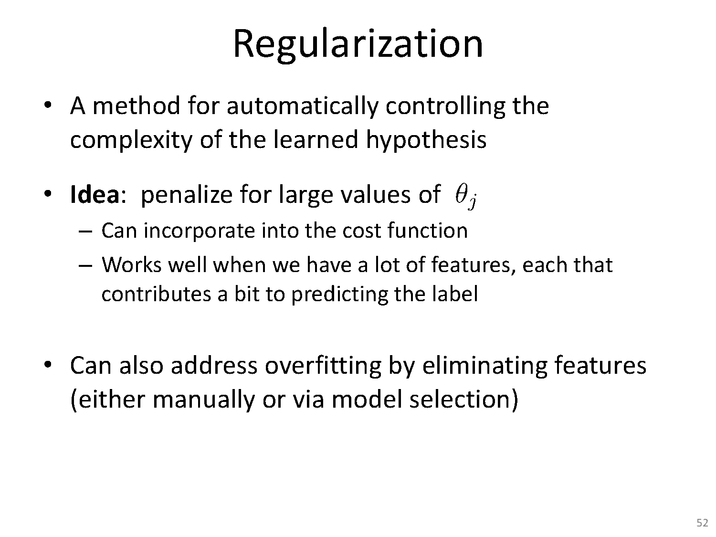

Slide 17
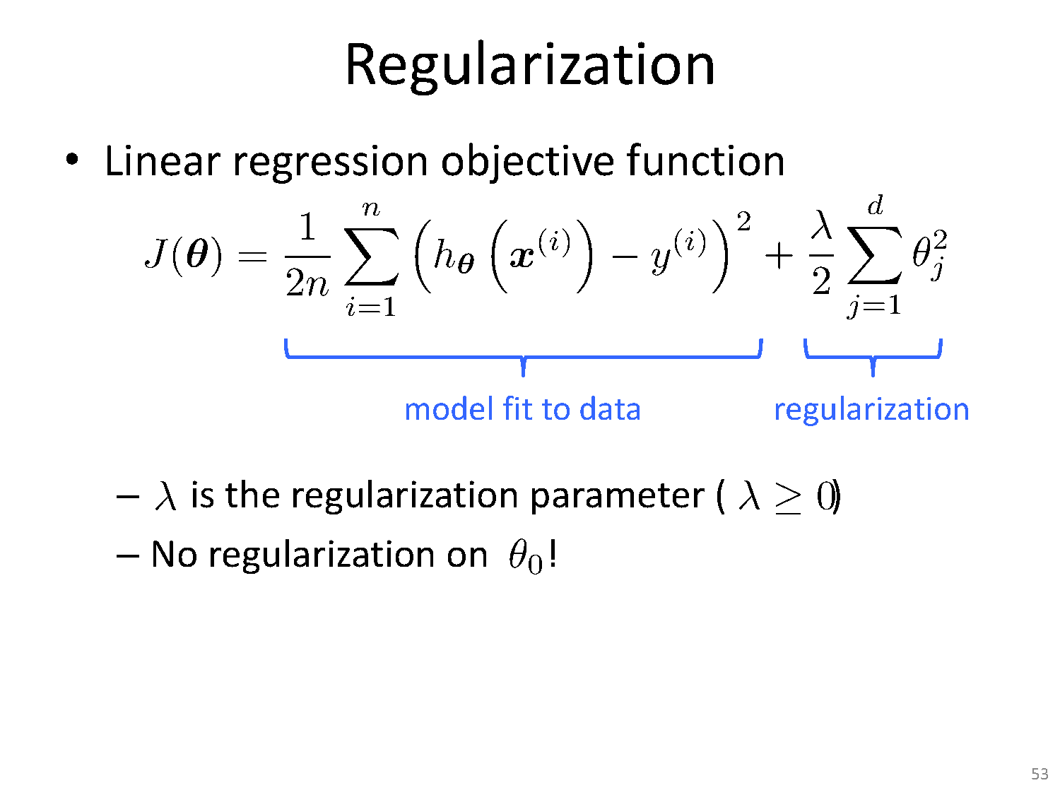

Slide 18
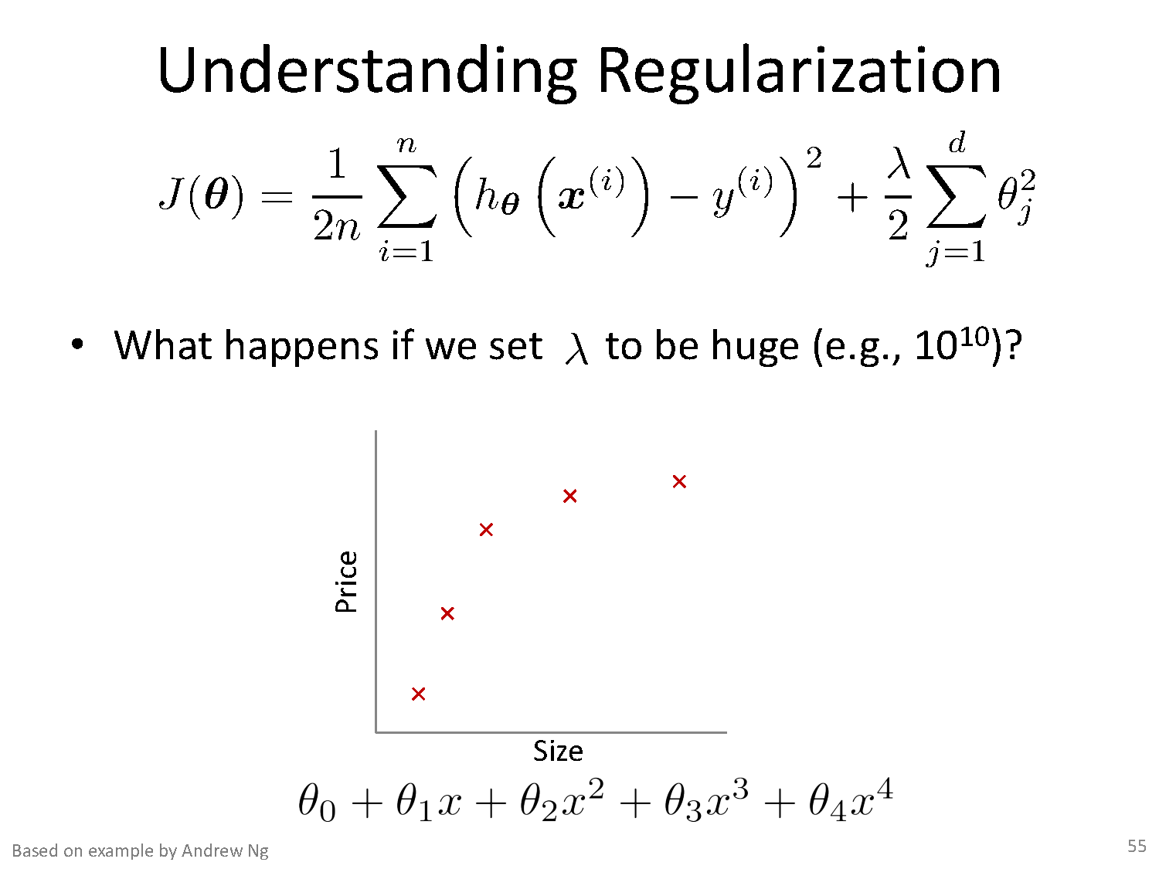

Slide 19
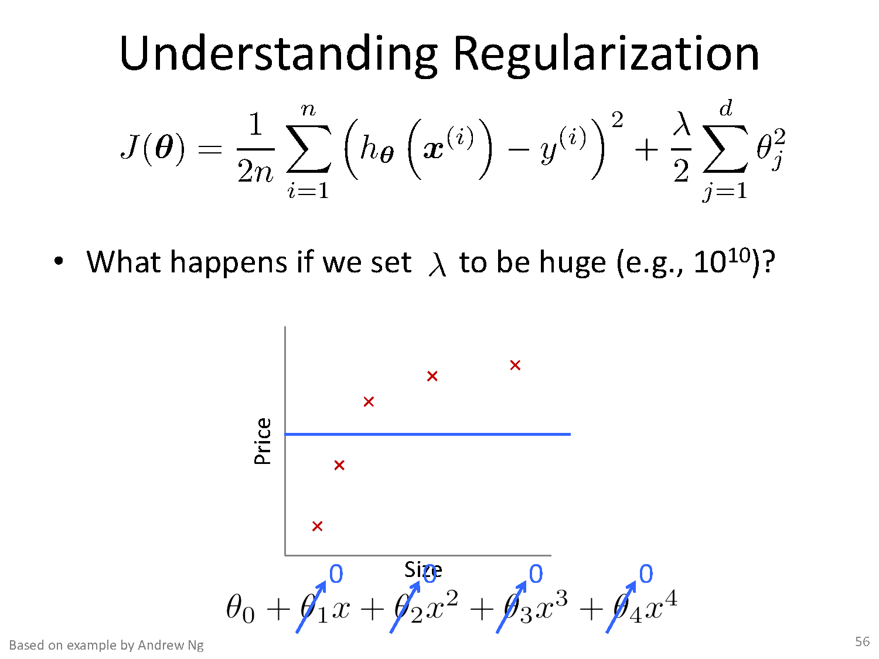

Slide 20
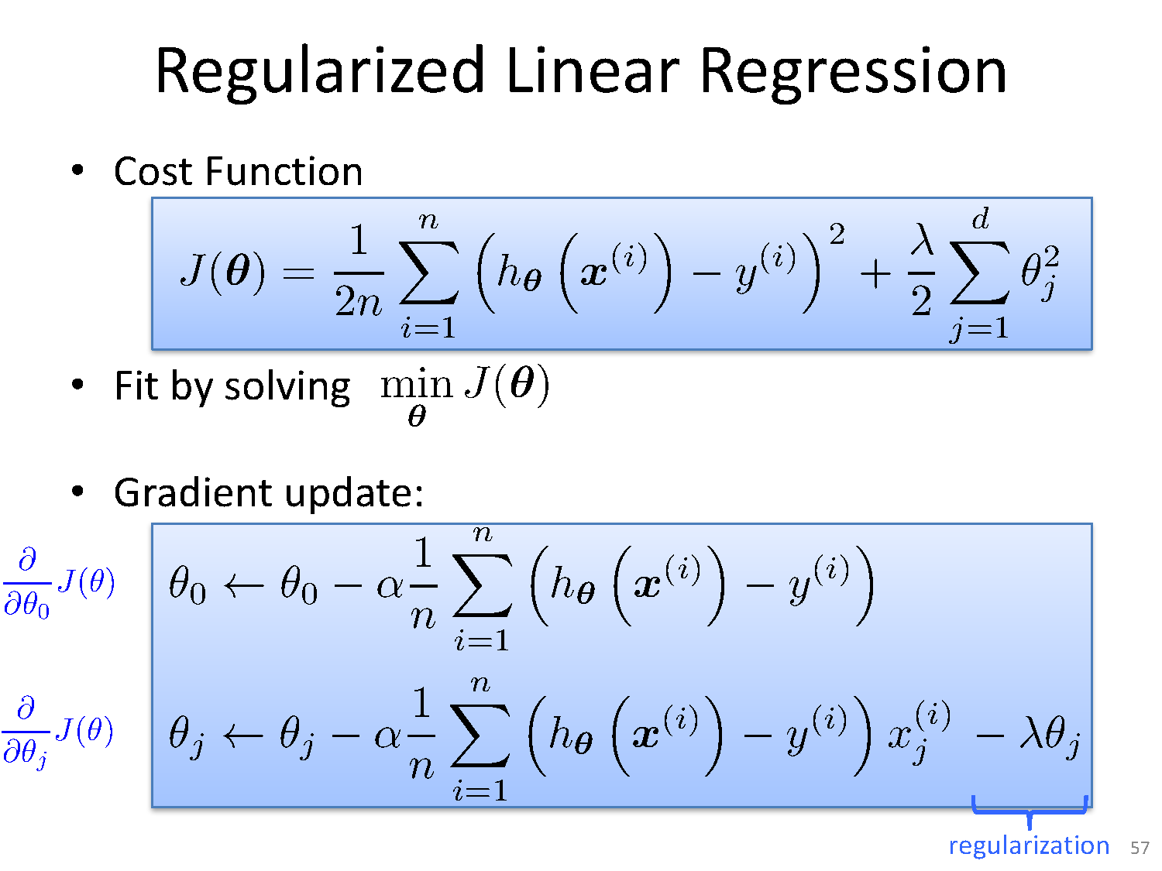

Slide 21
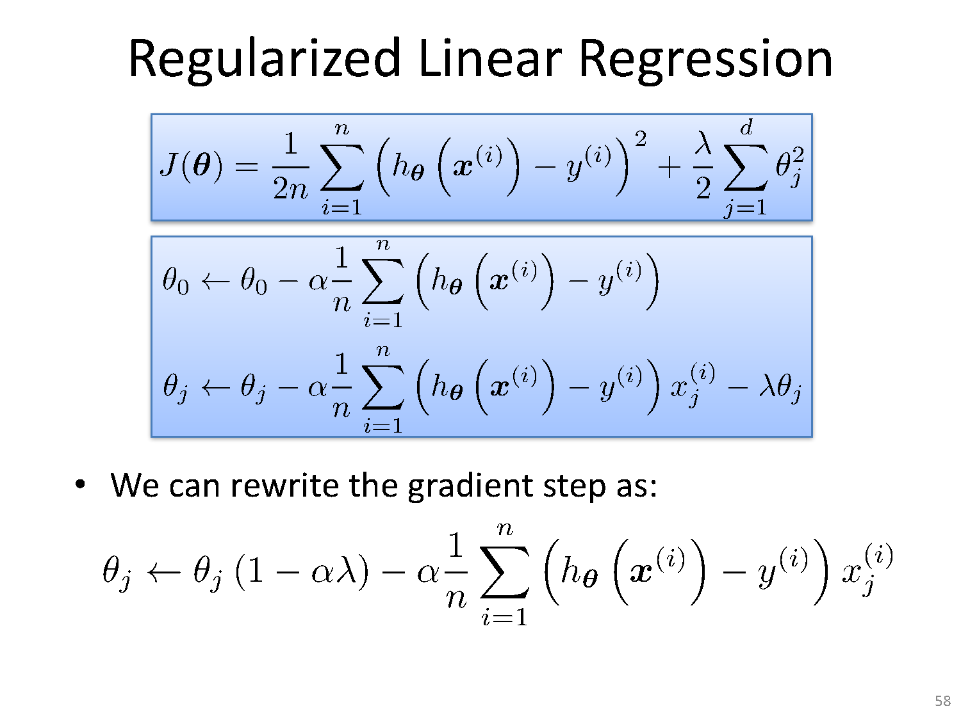

Slide 22
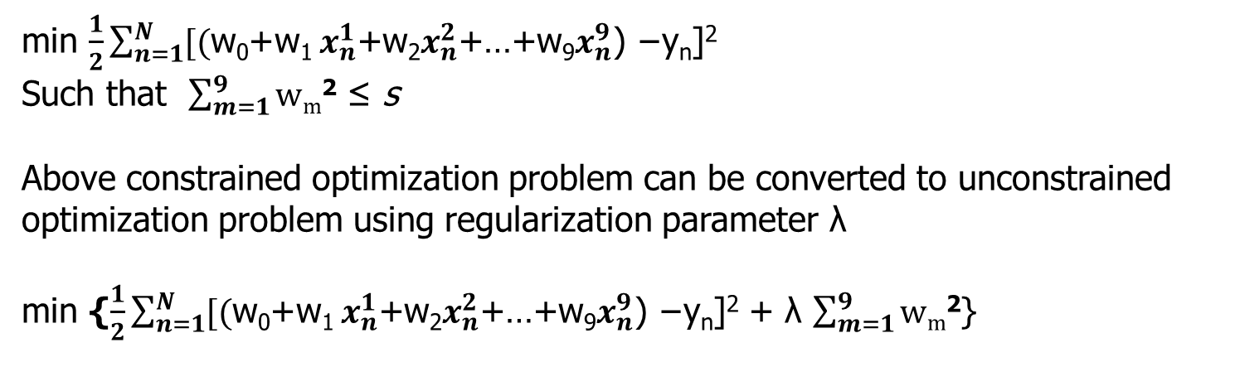
Ridge Regression
( x₁y₁, x₂y₂,…………. x_{n}y_{n})
min $\frac{1}{2}\sum_{n=1}^{N}{[\text{(}\text{w}\text{0}\text{+}\text{w}\text{1} x_{n}^{1}\text{+}\text{w}\text{2}x_{n}^{2}\text{+…+}\text{w}\text{9}x_{n}^{9}\text{) −}\text{yn}\text{]2}}$
Such that $\sum_{m=1}^{9}{\text{w}\text{m}\text{2}}$ ≤ s
Above constrained optimization problem can be converted to unconstrained optimization problem using regularization parameter λ
min {$\frac{1}{2}\sum_{n=1}^{N}{[\text{(}\text{w}\text{0}\text{+}\text{w}\text{1 }x_{n}^{1}\text{+}\text{w}\text{2}x_{n}^{2}\text{+…+}\text{w}\text{9}x_{n}^{9}\text{) −}\text{yn}\text{]2}}$ + λ $\sum_{m=1}^{9}{\text{w}\text{m}\text{2}}$}

Slide 23
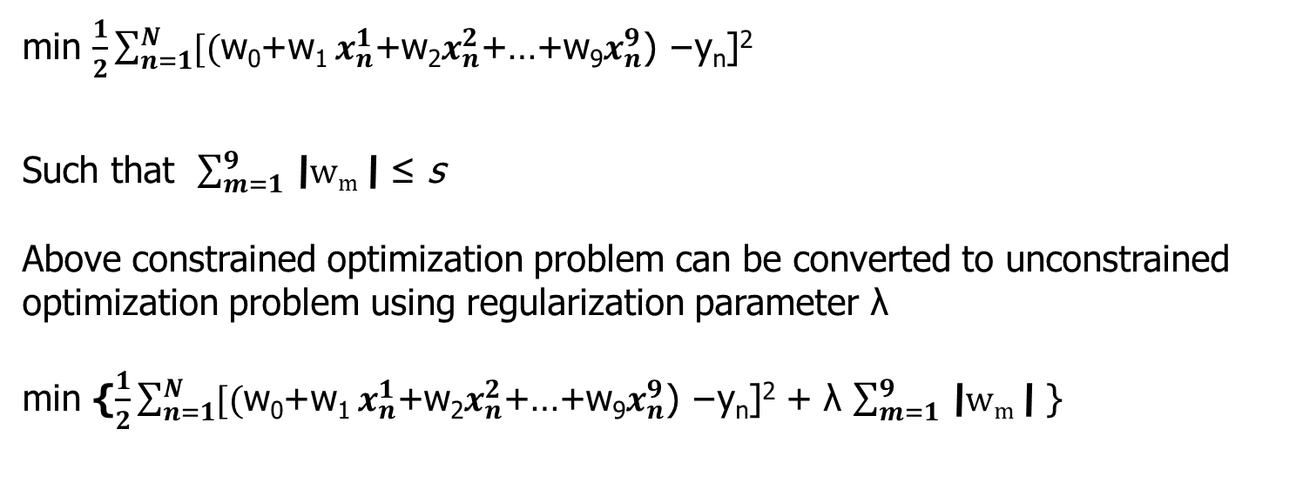
Lasso Regression
( x₁y₁, x₂y₂,…………. x_{n}y_{n})
min $\frac{1}{2}\sum_{n=1}^{N}{[\text{(}\text{w}\text{0}\text{+}\text{w}\text{1 }x_{n}^{1}\text{+}\text{w}\text{2}x_{n}^{2}\text{+…+}\text{w}\text{9}x_{n}^{9}\text{) −}\text{yn}\text{]2}}$
Such that $\sum_{m=1}^{9}{\text{\backslash }\text{w}\text{m}\text{\backslash }}$ ≤ s
Above constrained optimization problem can be converted to unconstrained optimization problem using regularization parameter λ
min {$\frac{1}{2}\sum_{n=1}^{N}{[\text{(}\text{w}\text{0}\text{+}\text{w}\text{1 }x_{n}^{1}\text{+}\text{w}\text{2}x_{n}^{2}\text{+…+}\text{w}\text{9}x_{n}^{9}\text{) −}\text{yn}\text{]2}}$ + λ $\sum_{m=1}^{9}{\text{\backslash }\text{w}\text{m}\text{\backslash }}$ }

Slide 24
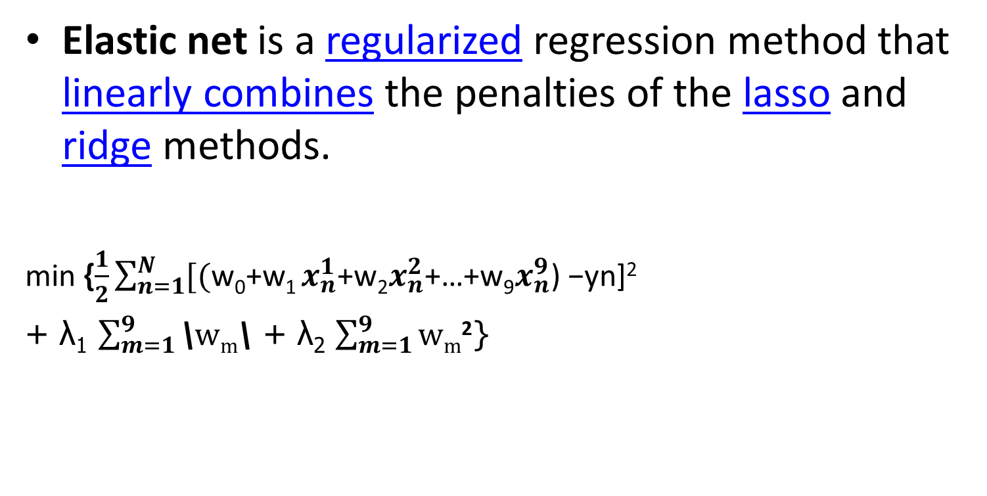
Elastic Net
Elastic net is a regularized regression method that linearly combines the penalties of the lasso and ridge methods.
min {$\frac{1}{2}\sum_{n=1}^{N}{[\text{(}\text{w}\text{0}\text{+}\text{w}\text{1 }x_{n}^{1}\text{+}\text{w}\text{2}x_{n}^{2}\text{+…+}\text{w}\text{9}x_{n}^{9}\text{) −}\text{yn}\text{]2}}$
+ λ₁ $\sum_{m=1}^{9}{\text{\backslash }\text{w}\text{m}\text{\backslash }}$ + λ₂ $\sum_{m=1}^{9}{\text{w}\text{m}\text{2}}$}

Slide 25
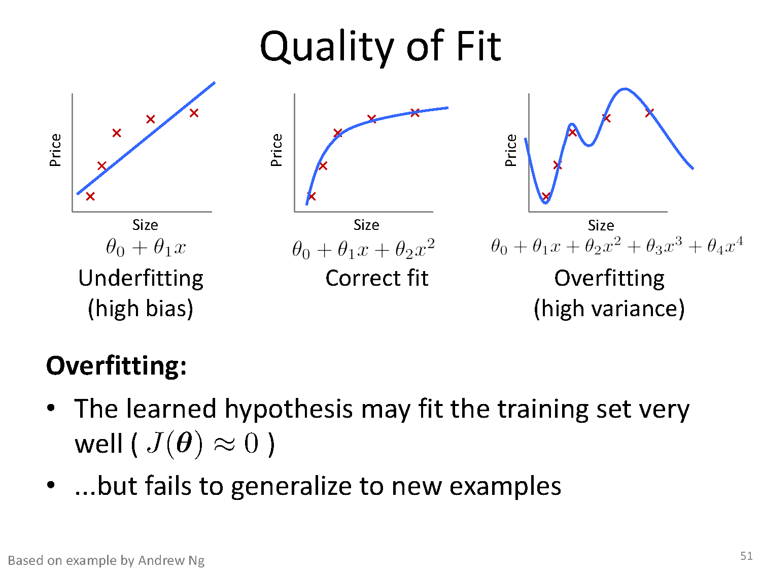

Slide 26
Bias-Variance Tradeoff
Bias: difference between what you expect to learn and truth
Measures how well you expect to represent true solution
Decreases with more complex model
Variance: difference between what you expect to learn and what you learn from a particular dataset
Measures how sensitive learner is to specific dataset
Increases with more complex model

Slide 27
Bias – Variance decomposition of error
E {( f (x) + ε − h (x)) }
2
D,ε
D
dataset and noise
learned from D
true function
noise
Fix test case x, then do this experiment:
Draw size n sample D=(x₁,y₁),….(x_{n},y_{n})
Train linear regressor h_{D} using D
Draw one test example (x, f(x)+ε)
Measure squared error of h_{D} on that example x
What’s the expected error?

Slide 28

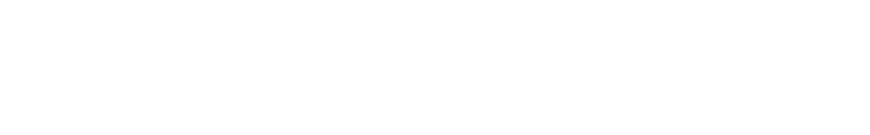

Bias – Variance decomposition of error
Notation - to simplify this
f ≡ f (x) + ε
yˆ = yˆ_{D} ≡ h_{D} (x)
2
E_{D,ε} { ( f (x) + ε − h_{D} (x))
}
dataset and noise
true function
learned from D
noise
h ≡ E_{D}{h_{D} (x)}
long-term expectation of learner’s prediction on this x averaged over many data sets D

Slide 29
Bias – Variance decomposition of error
h=E {yˆ }
2
E_{D,ε} { ( f − yˆ)
}
D D
2
= E { ([ f − h] +[h − yˆ])
}
yˆ = yˆ
≡ h (x)
= E { [ f − h]² +[h − yˆ]² + 2[ f − h][h − yˆ] }
= E { [ f − h]² +[h − yˆ]² + 2[ fh − fyˆ − h² + hyˆ] }
D D
f ≡ f (x) + ε
= E[( f − h)² ] + E[(h − yˆ)² ] + 2 (E[ fh] − E[ fyˆ] − E[h² ] + E[hyˆ])

Slide 30
Bias – Variance decomposition of error
h=E {yˆ }
2
E_{D,ε} { ( f − yˆ)
}
D D
2
= E { ([ f − h] +[h − yˆ])
}
yˆ = yˆ
≡ h (x)
= E { [ f − h]² +[h − yˆ]² + 2[ f − h][h − yˆ] }
= E { [ f − h]² +[h − yˆ]² + 2[ fh − fyˆ − h² + hyˆ] }
D D
f ≡ f (x) + ε
= E[( f − h)² ] + E[(h − yˆ)² ] + 2 (E[ fh] − E[ fyˆ] − E[h² ] + E[hyˆ])

Slide 31
Bias – Variance decomposition of error
h=E{yˆ }
yˆ = yˆ
f ≡ f (x) + ε
D
2 (E[ fh] − E[ fyˆ] − E[h² ] + E[hyˆ])
= E[ f]E[h]- E[ f ]E[yˆ] − E[h] E[h] + E[h] E[yˆ]
= E[ f]E[E[yˆ]]- E[ f ] E[yˆ]− E[h]E[E[yˆ]]+ E[h] E[yˆ]
= E[ f]E[yˆ] - E[f] E[yˆ] − E[h]E[yˆ] + E[h] E[yˆ]
=0

Slide 32
E { ( f − yˆ)²
Bias – Variance decomposition of error
}
D,ε
h ≡ E {h (x)}
2
= E { ([ f − h] +[h − yˆ])
}
D D
yˆ = yˆ_{D} ≡ h_{D} (x)
f ≡ f (x) + ε
= E { [ f − h]² +[h − yˆ]² + 2[ f − h][h − yˆ] }
= E[( f − h)² ] + E[(h − yˆ)² ]
BIAS²
Squared difference between best possible prediction for x, f(x), and our “long-term” expectation for what the learner will do if we averaged over many
VARIANCE
Squared difference btwn our long- term expectation for the learners performance, E_{D}[h_{D}(x)], and what we expect in a representative run on a dataset D (hat y)
datasets D, E_{D}[h_{D}(x)]
13

Slide 33
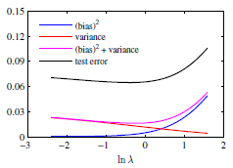
Relation between ln λ and variance, ln λ and bias
As λ increases variance comes down(red line)
As λ increases(w more constrained) bias also increases

Slide 34
Value of regularization parameter λ
If λ small, more flexible model, w can take larger values bias is low but variance is high
As λ increases, w more constrained. So bias also increases and variance is low
Right choice of λ is balance between bias and variance
0 < λ < 1
Pickup λ where the test error is minimum

Slide 35
Python Implementation Demo:
Polynomial Regression

Slide 36
Decision trees
Decision Trees is one of the most widely used and practical methods of classification
Method for approximating discrete-valued functions
Learned functions are represented as decision trees (or if-then-else rules)
Expressive hypotheses space

Slide 37
Decision Tree
Advantages:
– Inexpensive to construct
– Extremely fast at classifying unknown records
– Easy to interpret for small-sized trees
– Can easily handle redundant or irrelevant attributes (unless the attributes are interacting)
Disadvantages:
– Space of possible decision trees is exponentially large.
Greedy approaches are often unable to find the best tree.
– Does not take into account interactions between attributes
– Each decision boundary involves only a single attribute

Slide 38
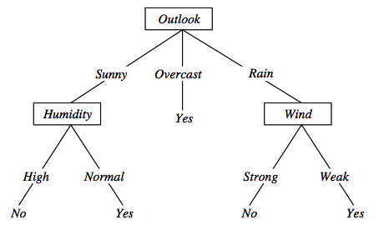
Decision tree representation (PlayTennis)
⟨Outlook=Sunny, Temp=Hot, Humidity=High, Wind=Strong⟩ No
Notes:
Each node represents a test on an attribute of the instance to be classified and each outgoing arch a possible outcome, leading to a further test.
The leafs correspond to classification actions. A binary classification in this case.
The instance <Outlook=Sunny, Temp=Hot, Humidity=High, Wind=Strong> is classified as No.

Slide 39
Decision trees expressivity
Decision trees represent a disjunction of conjunctions on constraints on the value of attributes:
(Outlook = Sunny ∧ Humidity = Normal) ∨
(Outlook = Overcast) ∨
(Outlook = Rain ∧ Wind = Weak)

Slide 40
Measure of Information
The amount of information (surprise element) conveyed by a message is inversely proportional to its probability of occurrence. That is
The mathematical operator satisfies above properties is the logarithmic operator.
10 October 2020

Slide 41

Entropy
Entropy of discrete random variable X={x₁, x₂…x_{n}}
; since: log₂(1/P(event))= -log₂P(event)
As uncertainty increases, entropy increases
Entropy across all values

Slide 42
Entropy in general
Entropy measures the amount of information in a random variable
H(X) = – p₊ log₂ p₊ – p– log₂ p– X = {+, –}
for binary classification [two-valued random variable]
c c
H(X) = – Σ p_{i} log₂ p_{i} = Σ p_{i} log₂ 1/ p_{i} X = {i, …, c}
i=1 i=1
for classification in c classes

Slide 43
Entropy in binary classification
Entropy measures the impurity of a collection of examples. It depends from the distribution of the random variable p.
S is a collection of training examples
p₊ the proportion of positive examples in S
p– the proportion of negative examples in S
Entropy (S) ≡ – p₊ log₂ p₊ – p–log₂ p– [0 log₂0 = 0]
Entropy ([14+, 0–]) = – 14/14 log₂ (14/14) – 0 log₂ (0) = 0
Entropy ([9+, 5–]) = – 9/14 log₂ (9/14) – 5/14 log₂ (5/14) = 0.94
Entropy ([7+, 7– ]) = – 7/14 log₂ (7/14) – 7/14 log₂ (7/14) =
= 1/2 + 1/2 = 1 [log₂1/2 = – 1]
Note: the log of a number < 1 is negative, 0 ≤ p ≤ 1, 0 ≤ entropy ≤ 1
https://www.easycalculation.com/log-base2-calculator.php
Notes:
S=[9+, 5-] una collezione di esempi di cui 9 positivi e 5 negativi

Slide 44
Information gain as entropy reduction
Information gain is the expected reduction in entropy caused by partitioning the examples on an attribute.
The higher the information gain the more effective the attribute in classifying training data.
Expected reduction in entropy knowing A
Gain(S, A) = Entropy(S) − Σ Entropy(S_{v})
v ∈ Values(A)
Values(A) possible values for A
S_{v} subset of S for which A has value v
|Sv|
|S|
Notes:
La riduzione in entropia attesa partizionando sui valori dell’ attributo A

Slide 45
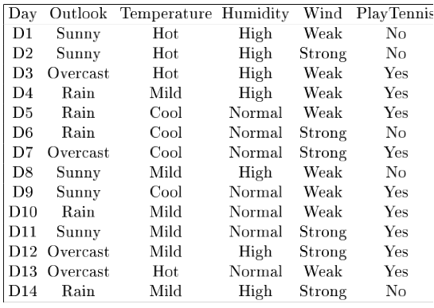
Example
Notes:
Target attrbute = playtennis

Slide 46
Example: Information gain
Let
Values(Wind) = {Weak, Strong}
S = [9+, 5−]
S_{Weak} = [6+, 2−]
S_{Strong} = [3+, 3−]
Information gain due to knowing Wind:
Gain(S, Wind) = Entropy(S) − 8/14 Entropy(S_{Weak}) − 6/14 Entropy(S_{Strong})
= 0.94 − 8/14 × 0.811 − 6/14 × 1.00
= 0.048
Since,
Entropy(S) = Entropy ([9+, 5–])= – 9/14 log₂ (9/14) – 5/14 log₂ (5/14) = 0.94
Entropy(S_{Weak}) = Entropy ([6+, 2−])= – 6/8 log₂ (6/8) – 2/8 log₂ (2/8) = 0.811
Entropy(S_{Strong}) = Entropy ([3+, 3−])= – 3/6 log₂ (3/6) – 3/6 log₂ (3/6) = 1

Slide 47
Example
Notes:
Target attrbute = playtennis

Slide 48
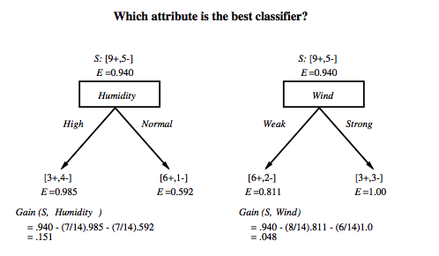
Which attribute is the best classifier?

Slide 49
First step: which attribute to test at the root?
Which attribute should be tested at the root?
Gain(S, Outlook) = 0.246
Gain(S, Humidity) = 0.151
Gain(S, Wind) = 0.084
Gain(S, Temperature) = 0.029
Outlook provides the best prediction for the target
Lets grow the tree:
add to the tree a successor for each possible value of Outlook
partition the training samples according to the value of Outlook

Slide 50
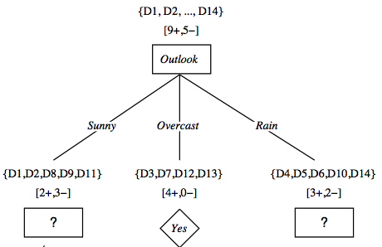
After first step

Slide 51
Second step
Working on Outlook=Sunny node:
Gain(S_{Sunny}, Humidity) = 0.970 − 3/5 × 0.0 − 2/5 × 0.0 = 0.970
Gain(S_{Sunny}, Wind) = 0.970 − 2/5 × 1.0 − 3.5 × 0.918 = 0 .019
Gain(S_{Sunny}, Temp.) = 0.970 − 2/5 × 0.0 − 2/5 × 1.0 − 1/5 × 0.0 = 0.570
Humidity provides the best prediction for the target
Lets grow the tree:
add to the tree a successor for each possible value of Humidity
partition the training samples according to the value of Humidity

Slide 52
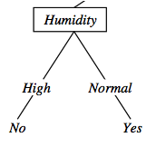
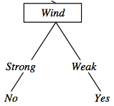
Second and third steps
{D1, D2, D8}
No
{D9, D11}
Yes
{D4, D5, D10}
Yes
{D6, D14}
No

Slide 53
ID3: algorithm
ID3(X, T, Attrs) X: training examples:
T: target attribute (e.g. PlayTennis),
Attrs: other attributes, initially all attributes
Create Root node
If all X's are +, return Root with class +
If all X's are –, return Root with class –
If Attrs is empty return Root with class most common value of T in X
else
A ← best attribute; decision attribute for Root ← A
For each possible value v_{i} of A:
- add a new branch below Root, for test A = v_{i}
- X_{i} ← subset of X with A = v_{i}
- If X_{i} is empty then add a new leaf with class the most common value of T in X
else add the subtree generated by ID3(X_{i}, T, Attrs − {A})
return Root

Slide 54
Prefer shorter hypotheses: Occam's razor
Why prefer shorter hypotheses?
Arguments in favor:
There are fewer short hypotheses than long ones
If a short hypothesis fits data unlikely to be a coincidence
Elegance and aesthetics
Arguments against:
Not every short hypothesis is a reasonable one.
Occam's razor says that when presented with competing hypotheses that make the same predictions, one should select the solution which is simple"

Slide 55
Issues in decision trees learning
Overfitting
Reduced error pruning
Rule post-pruning
Extensions
Continuous valued attributes
Handling training examples with missing attribute values
Notes:
L'overfitting può succedere quando c' è rumore nei dati.

Slide 56
Overfitting: definition
overfitting is "the production of an analysis that corresponds too closely or exactly to a particular set of data
Building trees that “adapt too much” to the training examples may lead to “overfitting”.
May therefore fail to fit additional data or predict future observations reliably
overfitted model is a statistical model that contains more parameters than can be justified by the data
Notes:
L' errore sul training e' minore e quindi ci appare come la migliore ipotesi
Ma l' errore nello spazio di tutti I possibili dati è maggiore.

Slide 57
Example
D15 Sunny Hot Normal Strong No
Notes:
L’ esempio D15 è sbagliato, introduce rumore nei dati.

Slide 58
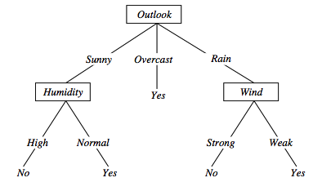
Overfitting in decision trees
⟨Outlook=Sunny, Temp=Hot, Humidity=Normal, Wind=Strong, PlayTennis=No ⟩
New noisy example causes splitting of second leaf node.
Notes:
The example shows that noise can lead to overfitting.
Overfitting without noise is also possible, especially when classifcation decision on the leafs are based on few examples. Uniform classification may be a coincidence.
This is a potential cause of overfitting.
Overfitting is a significant problem for DT, reducing the accuracy to 10-25% on many problems.

Slide 59
Avoid overfitting in Decision Trees
Two strategies:
Stop growing the tree earlier the tree, before perfect classification
Allow the tree to overfit the data, and then post-prune the tree
Training and validation set
split the training in two parts (training and validation) and use validation to assess the utility of post-pruning
Reduced error pruning
Rule post pruning
Notes:
Usando tutti dati di training, un test statistico può predire l’ influenza delle decisioni se espandere (o potare) sulle prestazioni su tutto X.
Minimum description length principle, un principio di compattezza della rappresentazione.

Slide 60
Reduced-error pruning
Each node is a candidate for pruning
Pruning consists in removing a subtree rooted in a node: the node becomes a leaf and is assigned the most common classification
Nodes are removed only if the resulting tree performs no worse on the validation set.
Nodes are pruned iteratively: at each iteration the node whose removal most increases accuracy on the validation set is pruned.
Pruning stops when no pruning increases accuracy
Notes:
Potatura sulla base di errori ridotti, valutati sul validation set.

Slide 61
Rule post-pruning
Create the decision tree from the training set
Convert the tree into an equivalent set of rules
Each path corresponds to a rule
Each node along a path corresponds to a pre-condition
Each leaf classification to the post-condition
Prune (generalize) each rule by removing those preconditions whose removal improves accuracy …
… over validation set
Sort the rules in estimated order of accuracy, and consider them in sequence when classifying new instances

Slide 62
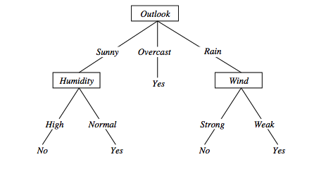
Converting to rules
(Outlook=Sunny)∧(Humidity=High) ⇒ (PlayTennis=No)

Slide 63
Rule Post-Pruning
Convert tree to rules (one for each path from root to a leaf)
For each antecedent in a rule, remove it if error rate on validation set does not decrease
Sort final rule set by accuracy
Compare first rule to:
Outlook=sunny->No
Humidity=high->No
Calculate accuracy of 3 rules
based on validation set and
pick best version.
Outlook=sunny ^ humidity=high -> No
Outlook=sunny ^ humidity=normal -> Yes
Outlook=overcast -> Yes
Outlook=rain ^ wind=strong -> No
Outlook=rain ^ wind=weak -> Yes

Slide 64
Why converting to rules?
Each distinct path produces a different rule: a condition removal may be based on a local (contextual) criterion. Node pruning is global and affects all the rules
Provides flexibility of not removing entire node
In rule form, tests are not ordered and there is no book-keeping involved when conditions (nodes) are removed
Converting to rules improves readability for humans

Slide 65
Dealing with continuous-valued attributes
Given a continuous-valued attribute A, dynamically create a new attribute A_{c}
A_{c} = True if A < c, False otherwise
How to determine threshold value c ?
Example. Temperature in the PlayTennis example
Sort the examples according to Temperature
Temperature 40 48 | 60 72 80 | 90
PlayTennis No No 54 Yes Yes Yes 85 No
Determine candidate thresholds by averaging consecutive values where there is a change in classification: (48+60)/2=54 and (80+90)/2=85

Slide 66
Problems with information gain
Natural bias of information gain: it favors attributes with many possible values.
Consider the attribute Date in the PlayTennis example.
Date would have the highest information gain since it perfectly separates the training data.
It would be selected at the root resulting in a very broad tree
Very good on the training, this tree would perform poorly in predicting unknown instances. Overfitting.
The problem is that the partition is too specific, too many small classes are generated.
We need to look at alternative measures …

Slide 67
An alternative measure: gain ratio
c |S_{i} | |S_{i} |
SplitInformation(S, A) ≡ − Σ log₂ i=1 |S | |S |
S_{i} are the sets obtained by partitioning on value i of A
SplitInformation measures the entropy of S with respect to the values of A. The more uniformly dispersed the data the higher it is.
Gain(S, A)
GainRatio(S, A) ≡
SplitInformation(S, A)
GainRatio penalizes attributes that split examples in many small classes such as Date. Let |S |=n, Date splits examples in n classes
SplitInformation(S, Date)= −[(1/n log₂ 1/n)+…+ (1/n log₂ 1/n)]= −log₂1/n =log₂n
Compare with A, which splits data in two even classes:
SplitInformation(S, A)= − [(1/2 log₂1/2)+ (1/2 log₂1/2) ]= − [− 1/2 −1/2]=1
Notes:
2^{-x} = 1/2^{x}

Slide 68
Handling missing values training data
How to cope with the problem that the value of some attribute may be missing?
The strategy: use other examples to guess attribute
Assign the value that is most common among the training examples at the node
Assign a probability to each value, based on frequencies, and assign values to missing attribute, according to this probability distribution

Slide 69
Applications
Suited for following classification problems:
Applications whose Instances are represented by attribute-value pairs.
The target function has discrete output values
Disjunctive descriptions may be required
The training data may contain missing attribute values
Real world applications
Biomedical applications
Manufacturing
Banking sector
Make-Buy decisions

Slide 70
Python Implementation Demo:
Decision Tree

Slide 71
Extra slides

Slide 72
Skewness or Kurtosis
Skewness is the measure of symmetry or asymmetry of data distribution.
A distribution or data set is said to be symmetric if it looks the same to the left and right points of the center.
Kurtosis is the characteristic of being flat or peaked. It is a measure of whether data is heavy-tailed or light-tailed in a normal distribution
histogram is an effective way to show both the skewness and kurtosis of a data set because you can easily spot if something is wrong with your data. A probability plot is also a great tool because a normal distribution would just follow the straight line
best way to fix it is to perform a log transform of the same data, with the intent to reduce the skewness
you can also conduct a boxcox transform. scipy does all the hardwork for you.
apply a square root transformation via Numpy, by calling the sqrt() function

Slide 73
R^2 Error - BIASED ESTIMATE
Advertising (in lakhs of rupees) | Sales (in lakhs of rupees)
10 | 520
20 | 625
35 | 700
50 | 780
20 | 605
Predicting sales of an item
Variability without considering the independent variable is much more than the variability considering the dependent variable. i.e TSS >> RSS

Slide 74
Good References
Decision Tree
https://www.youtube.com/watch?v=eKD5gxPPeY0&list=PLBv09BD7ez_4temBw7vLA19p3tdQH6FYO&index=1
Overfitting
https://www.youtube.com/watch?time_continue=1&v=t56Nid85Thg
https://www.youtube.com/watch?v=y6SpA2Wuyt8

Slide 75
Good links
https://towardsdatascience.com/regularization-in-machine-learning-76441ddcf99a
https://www.youtube.com/watch?v=SjQyLhQIXSM
https://www.youtube.com/watch?v=2BH49JG_sTs&feature=emb_rel_pause
https://www.youtube.com/watch?v=EuBBz3bI-aA
Polynomial regression Python code
https://acadgild.com/blog/polynomial-regression-understand-power-of-polynomials
https://www.youtube.com/watch?v=NGf0voTMlcs

Slide 76
Python code references
Detecting outliers
https://towardsdatascience.com/ways-to-detect-and-remove-the-outliers-404d16608dba
https://mc.ai/difference-between-batch-gradient-descent-bgd-minibatch-gradient-descentmgd-and-stochastic/
https://towardsdatascience.com/learning-parameters-part-3-ee8558f65dd7
https://www.geeksforgeeks.org/gradient-descent-algorithm-and-its-variants/?ref=rp

